Slide 1

Project on COVID-19 India
Group 4B
-Mohit Namdev
-Sarthak Shadangi
-Neelam Sambnani
-Duddukuru Anusha

Slide 2
Agenda
Introduction
Data pre-processing
Challenges faced
State wise testing ratio
Top 10 states with best recovery rate
District wise delta variant analysis
State wise confirmed cases
State wise tested & confirmed cases
Dashboard
Conclusion

Slide 3
Introduction
COVID-19 is the name of the “novel coronavirus” disease.
SARS-CoV-2 is the name of the virus that causes COVID-19.
We were provided with a COVID-19 dataset of India.
The dataset we were provided was in JSON format.
Problem Statement- To showcase the severity of COVID-19 cases in India, state wise & district wise.

Slide 4
Data pre-processing
No. of datasets provided initially- 3
Format of the dataset- .JSON file
Tools used for data pre-processing-
Python- Used Numpy & Pandas to convert .JSON file into .CSV file & outlier handling.
Excel- To study & get familiar with the data along with null handling, creating graph & dashboard creation.
SQL- For aggregation of the data and to come up with major insights.

Slide 5
Challenges faced
Data cleaning was a very challenging part for this kind of dataset.
There were a lot of null values present in the dataset which was difficult to analyze and get insights, so we handled the null values with appropriate values.
The data was very large and complex, with different formats and structures. Processing and analyzing large datasets was computationally intensive and require specialized tools and techniques.
All the group members had different preferred timings as some of us were working professionals, but we collaborated really well and managed time accordingly for this project.

Slide 6
State wise testing ratio
Category A: 0.05 ≤ tr ≤ 0.1
Category B: 0.1 < tr ≤ 0.3
Category C: 0.3 < tr ≤ 0.5
Category D: 0.5 < tr ≤ 0.75
Category E: 0.75 < tr ≤ 1.0
Testing ratio(tr) =
(number of tests done)/
(population)

Slide 7
Top 10 states with best recovery rate

Slide 8
District wise delta variant analysis

Slide 9
State wise confirmed cases

Slide 10
State wise tested & confirmed cases

Slide 11
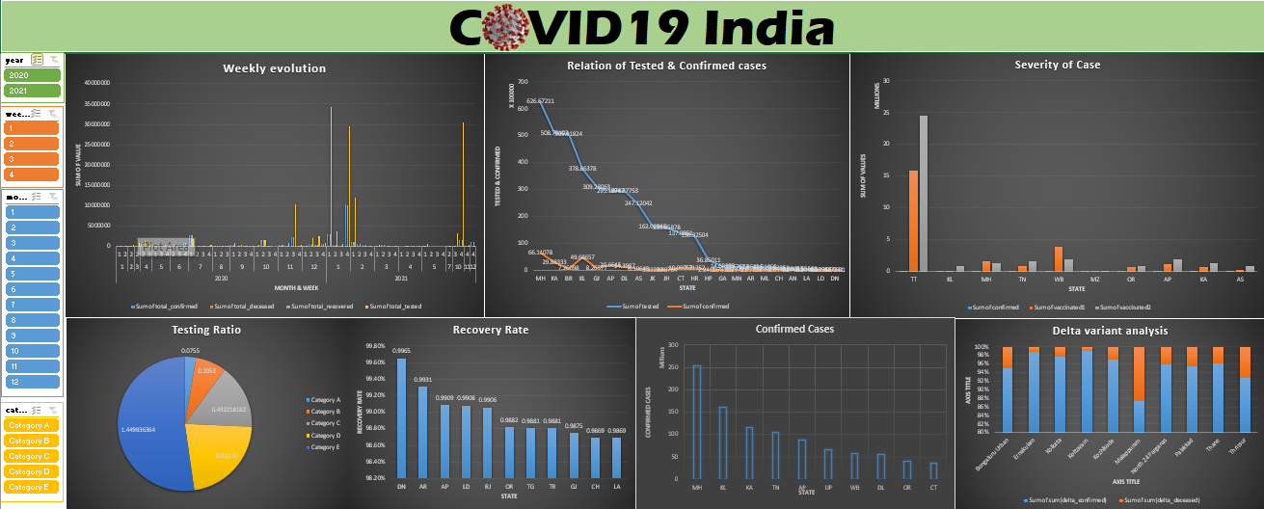

Slide 12
Conclusion
Maharashtra had the most number of confirmed cases.
Daman & Diu had the best recovery rate.
Ernakulum district of Kerala had the most number of delta confirmed cases.
Most number of testing was carried out in Uttar Pradesh.

Slide 13
Thank You

